Slide 1
Topology Optimization of Loaded Knee Structure with a Maximum Stress Constraint

Slide 2
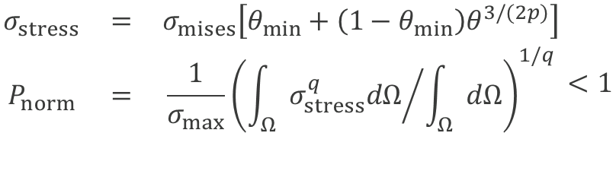
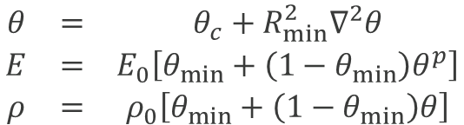
Stress Constrained Topology Optimization
Interpolation Functions
Young’s modulus and density uses standard formulation (from volume constrained compliance minimization)
The stress used for the constraint evaluation is interpolated differently
A p-norm is used to aggregate the pointwise stress constraint to a single global constraint
A compliance constraint is added to prevent flimsy structures
Two load cases are considered in order to give robustness towards the loading direction
$$\begin{matrix}θ & = & θ_{c}+R_{min}^{2}∇^{2}θ \\ E & = & E_{0}\left[θ_{min}+\left(1−θ_{min}\right)θ^{p}\right] \\ ρ & = & ρ_{0}\left[θ_{min}+\left(1−θ_{min}\right)θ\right]\end{matrix}$$
$$\begin{matrix}σ_{stress} & = & σ_{mises}\left[θ_{min}+\left(1−θ_{min}\right)θ^{3/(2p)}\right] \\ P_{norm} & = & \frac{1}{σ_{max}}{\left({\int_{Ω}{σ_{stress}^{q}dΩ}}/{\int_{Ω}{dΩ}}\right)}^{1/q} \\ & & \end{matrix}<1$$
Topology Optimization of Loaded Knee Structure with a Maximum Stress Constraint

Slide 3
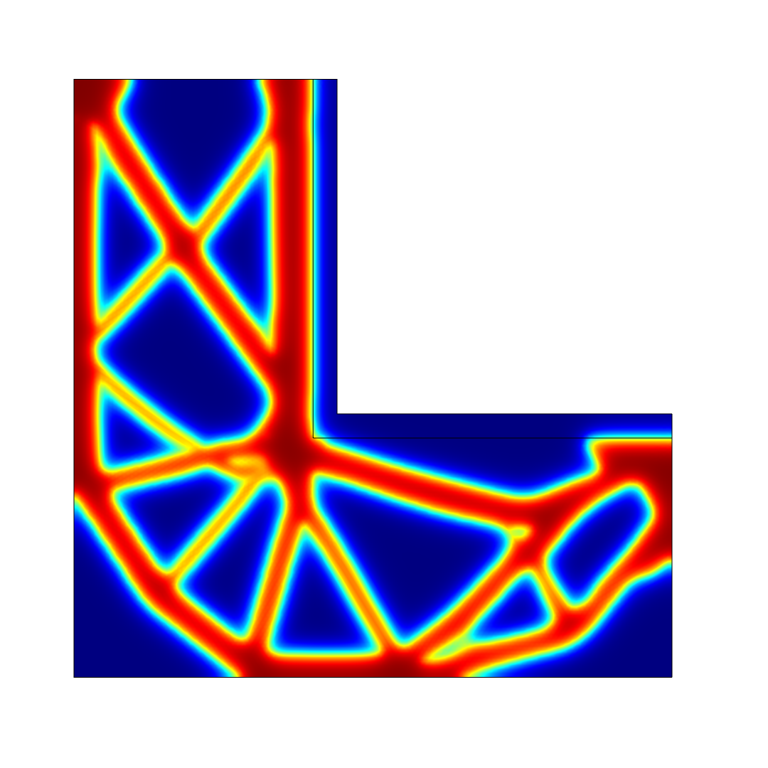
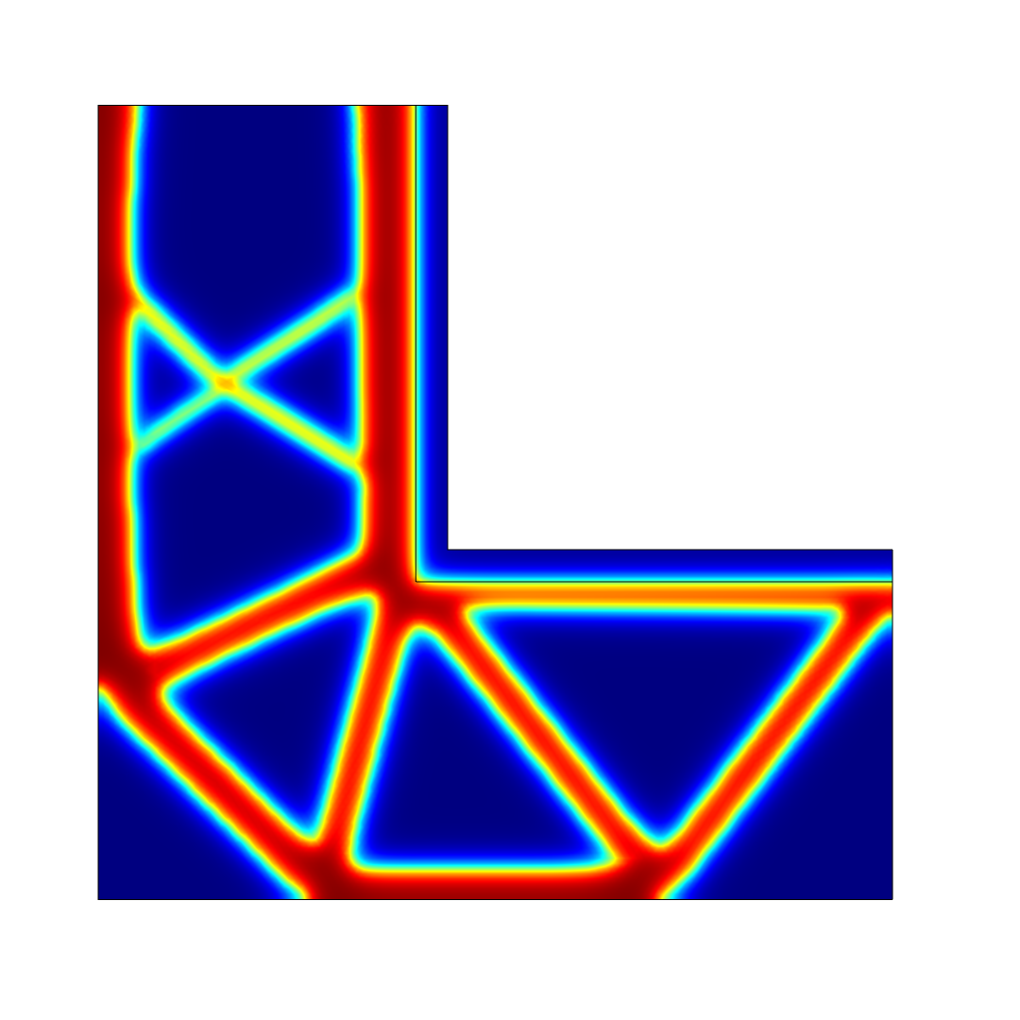


Comparison 200 and 400 kPa for the Stress Constraint
$$σ_{max}=200 kPa$$
$$σ_{max}=400 kPa$$
Topology Optimization of Loaded Knee Structure with a Maximum Stress Constraint

Slide 4
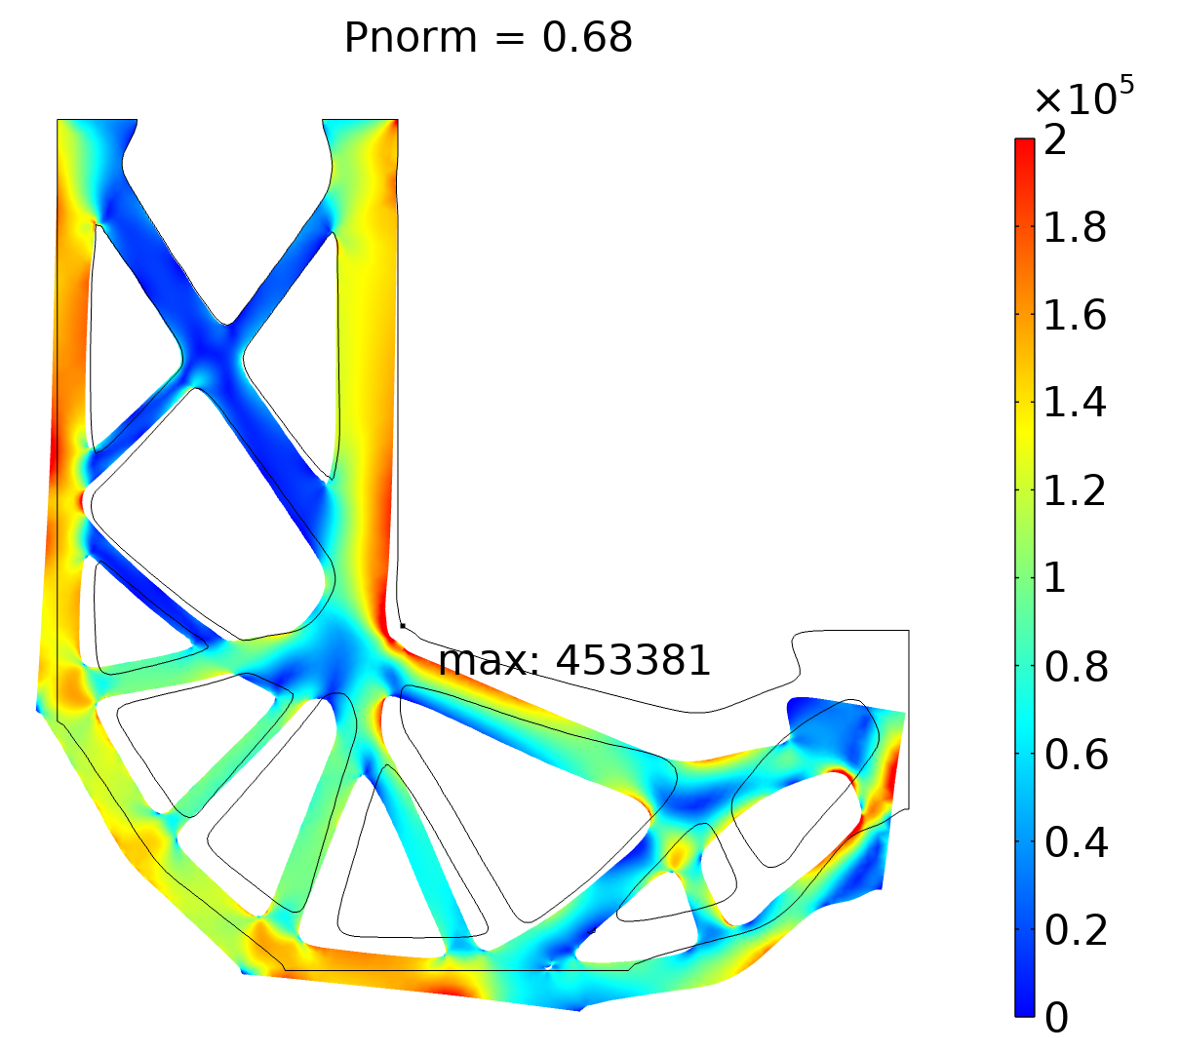
Verification
Conclusions
Aggregated p-norm constraint is satisfied
Maximum stress is violated
The stress constraint clearly reduces the stress, but it does not provide explicit control of the maximum stress
Topology Optimization of Loaded Knee Structure with a Maximum Stress Constraint

